Slide 1


VPN IPSEC TUNNELING
Prepared By:-
Student Name : SHAH AYUSH KISHAN
Roll no:164
Enrollment No:21002170110167
Batch: 3B Branch : C.E

Slide 2
INTRODUCTION
VPN=Virtual Private Network
IPsec is a group of protocols that are used together to set up encrypted connections between devices. It helps keep data sent over public networks secure. It used to set up VPNs , and it works by encrypting IP packets, along with authenticating the source where the packets come from.
IPsec stands : Internet Protocol secure.
VPN : An encrypted connection between two or more computers.

Slide 3
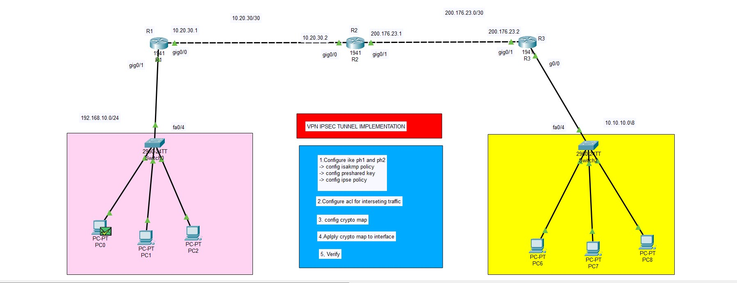
SYSTEM VEIW

Slide 4
COMMAND USED TO CREATE VPN TUNNEL
COMMAND TO VERIFY VPN TUNNELING
License boot module c1900 technology-package securityk9:
Crypto isakmp policy <1-1000>:
H: hashing:
A:authentication:pre share type G:group:diffie hellman : group 5 l:lifetime: 4000 E:encryption:aes:advanced encryption std.
Crypto isakmp key (your choice) (enter opp address):should be same in both router.
Crypto IPsec transform set(name of ts):
Here used esp-aes, esp-sha-hmac.
Config acl send ip receiver ip.
Setup crypto map
Show crypto IPsec sa: It shows whether the tunnel created or not. Encryption msg sent or not. Show records of How many successful msg has been sent.
Show crypto isakmp policy: Shows the status of policy
Show crypto IPsec transform set: Shows our configurations of transform set.

Slide 5
MERITS
DEMERITS
Bypass Geo-locked Content
Provide Safety Through Anonymity
Secure Connection for Remote Work
Save Money on Region-Based eCommerce
Slow Connection Speeds
VPN Blocking Software Exists
Complicated Set Up
Gaming Cons

Slide 6
THANK YOU….

